Slide 1


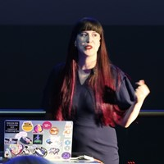


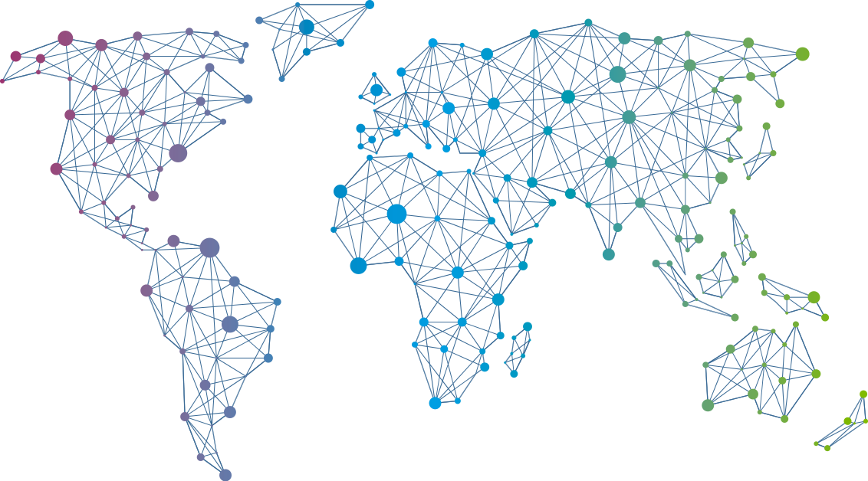

Speaker
Tanya Janca
More than just pipelines: DevSecOps
Security is everybody's job!
Tanya Janca
shehackspurple
September 16th & 17th
^{Online Event}
Powered By
International Conference

